Slide 1


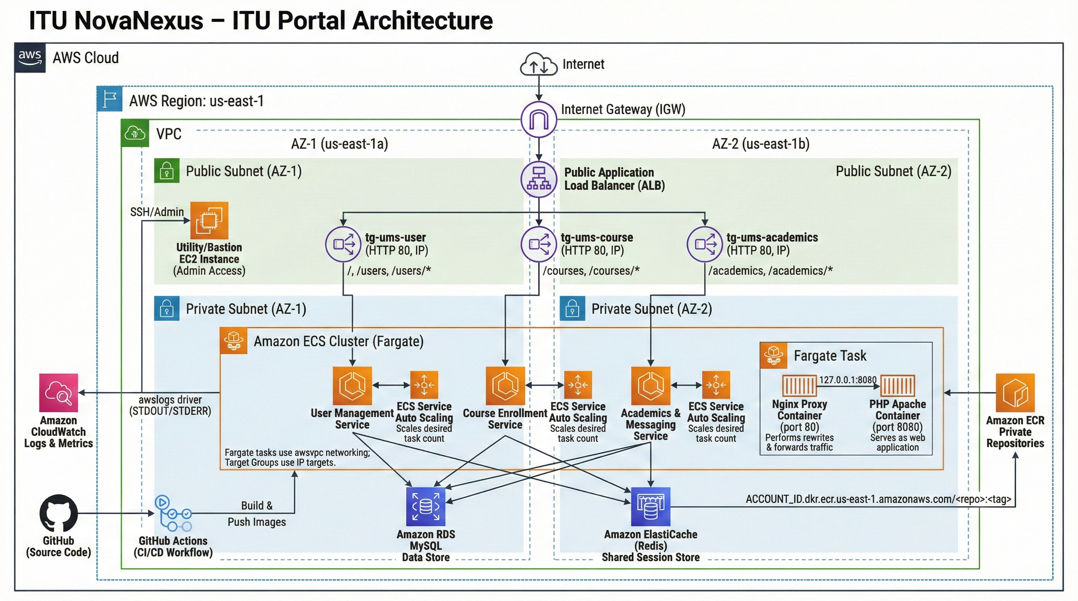
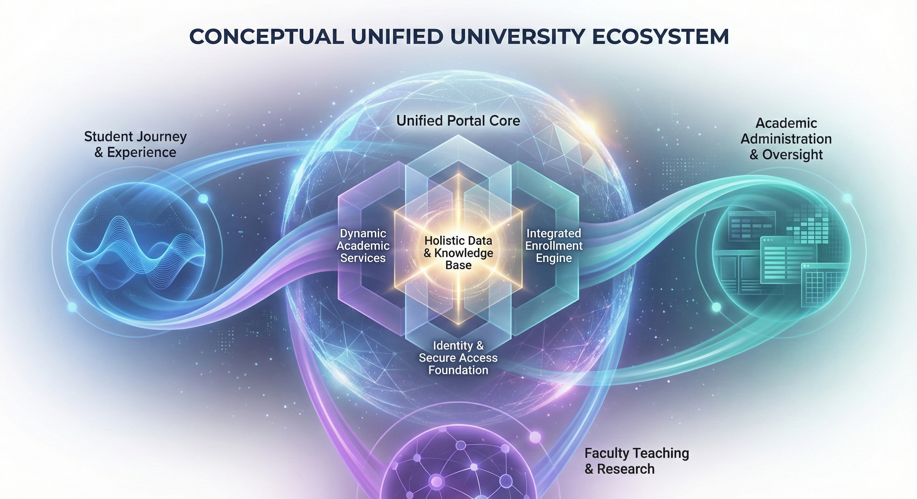
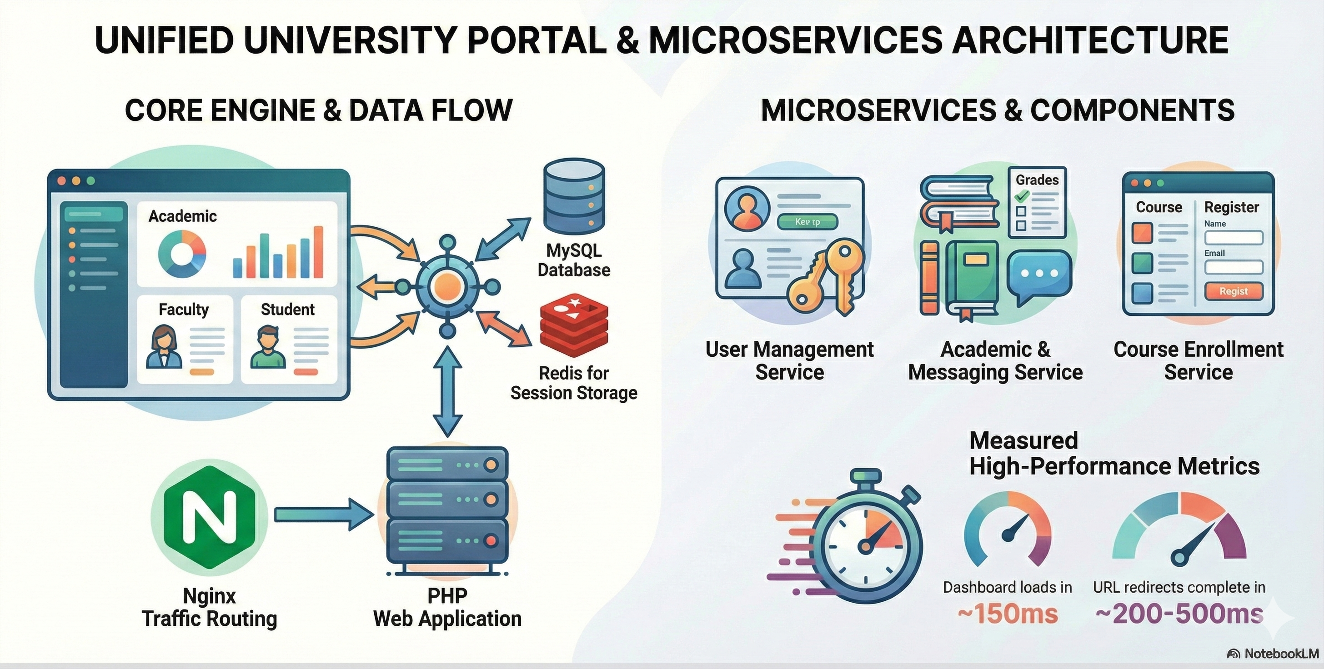
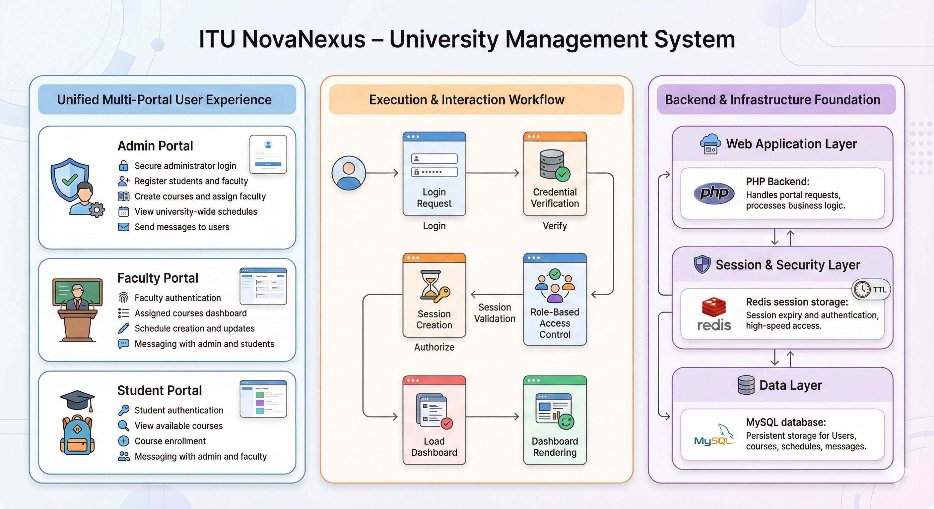
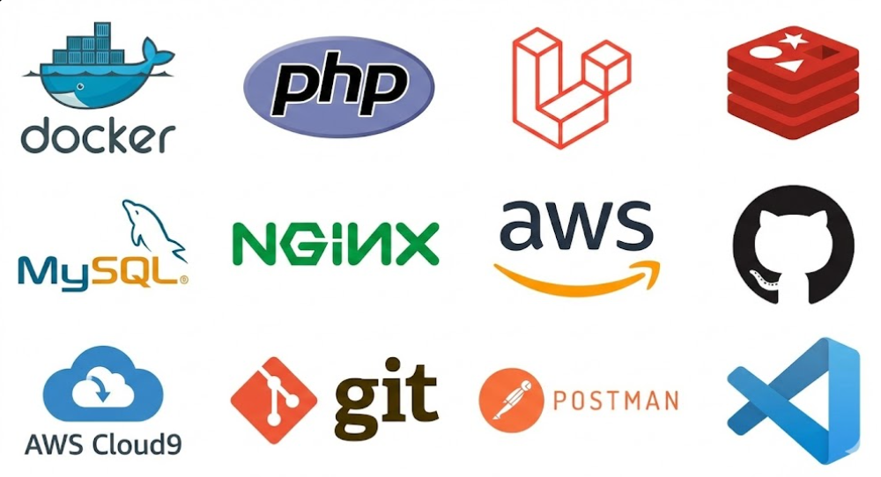
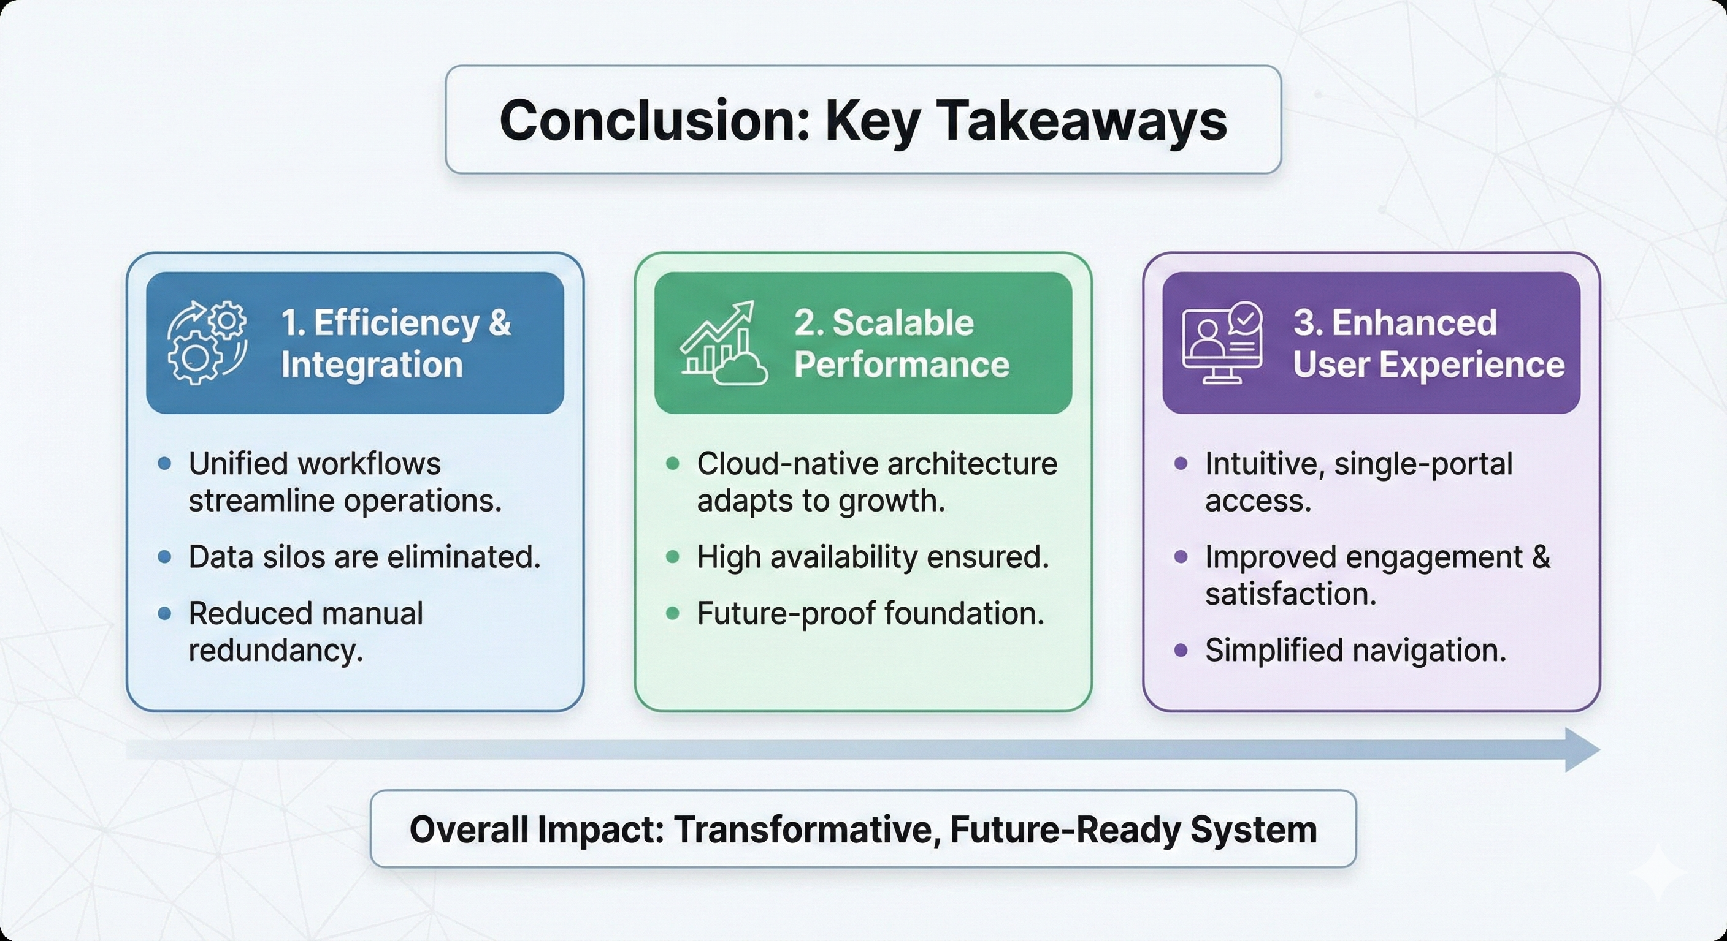
ITU NovaNexus: ITU Portal Architecture
Muhammad Abdul Qadir and Muhammad Samad
Dr Zunnurain Hussain | Sir Umair Makhdoom Semester Project | Dec 2025
Introduction
Objective
.
Ensure Scalability: Implement a microservices-based design to handle peak enrollment traffic without crashing.
Unify Access: Consolidate academic, administrative, and enrollment, functions into one platform.
Enhance Performance: Achieve sub-second dashboard load times using high-speed caching.
The Problem: Many universities use old, separate computer systems that do not "talk" to each other. This spreads data out and makes administrative work slow and difficult.
The Solution: This project creates a "Unified University Portal." It is a single website that brings Admins, Faculty, and Students together in one place.
Unified Ecosystem Overview
System Design
Table 1 – How to build a table for a poster
Title
Value 1 | 1 | 2 | 3
Value 2 | 4 | 5 | 6
Value 3 | 7 | 8 | 9
Value 4 | 10 | 11 | 12
This table only shows key figures & is easily understood. The side box gives a brief description of what is in the table
Microservices Structure: Decouples logic into distinct User Management, Academic & Messaging, and Course Enrollment services for modular scalability.
Traffic Routing: Utilizes Nginx to efficiently route traffic directly to the PHP web application engine.
Hybrid Storage: Integrates MySQL for persistent data storage (grades, users) and Redis for high-speed session caching.
Enter your discussion text here.
Enter your discussion text here
Enter your discussion text here
Enter your discussion text here
Connects Everyone: The "Unified Portal Core" links Students, Faculty, and Admins together in one place.
Shared Data: Stores all university information in a central "Holistic Knowledge Base" so nothing is lost.
This figure shows trends & is easily understood.
The side box gives a brief description of what is in the figure.
Methodology
Tools and Platform
Traffic Entry & Distribution: Site access is managed via an Internet Gateway, with traffic routed and balanced by the Application Load Balancer (ALB) through its DNS name.
Scalable Compute: PHP microservices and Nginx reverse proxies run within auto-scaling, serverless ECS Fargate containers.
Managed Data Layer: Utilizes Multi-AZ RDS MySQL for reliable persistent storage and ElastiCache Redis for high-speed session caching.
Automated CI/CD: Automated deployment pipeline powered by GitHub Actions to build Docker images and deploy updates to ECS Fargate.

